Slide 1

Simple Linear Regression A complete project for Prediction of car speed
Dr. Rakhee Chhibber

Slide 2
Simple Linear Regression
This is the simplest form of linear regression, and it involves only one independent variable and one dependent variable. The equation for simple linear regression is:
y=β0+β1X where:
Y is the dependent variable
X is the independent variable
β0 is the intercept
β1 is the slope

Slide 3
Multiple Linear Regression
This involves more than one independent variable and one dependent variable. The equation for multiple linear regression is:
y=β0+β1X1+β2X2+………βnXn where:
Y is the dependent variable
X1, X2, …, Xn are the independent variables
β0 is the intercept
β1, β2, …, βn are the slopes

Slide 4
Goal of Linear Regression
To find the best Fit Line equation that can predict the values based on the independent variables.
In regression set of records are present with X and Y values and these values are used to learn a function so if you want to predict Y from an unknown X this learned function can be used. In regression we have to find the value of Y, So, a function is required that predicts continuous Y in the case of regression given X as independent features.

Slide 5
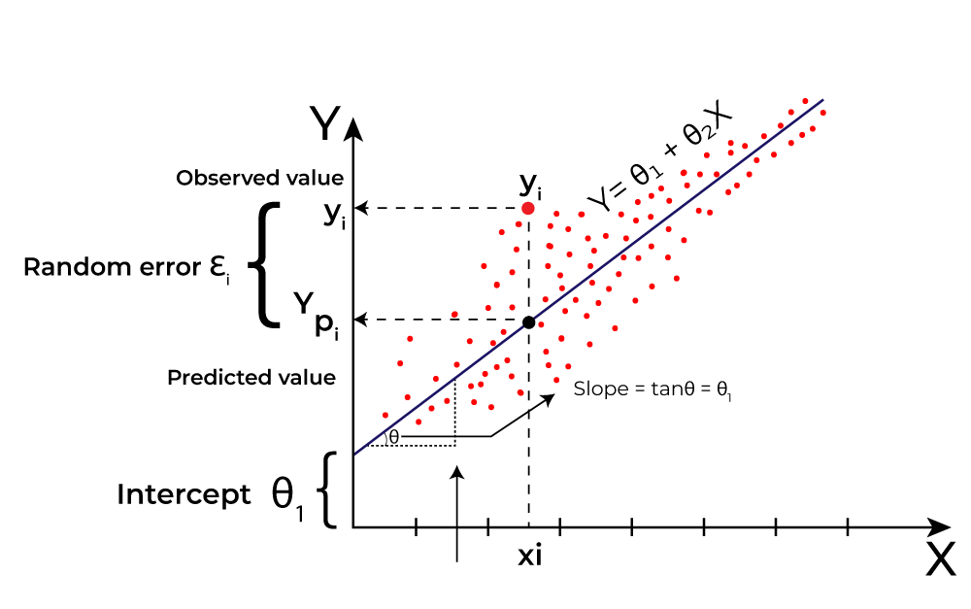
What is the best Fit Line?
Our primary objective while using linear regression is to locate the best-fit line, which implies that the error between the predicted and actual values should be kept to a minimum. There will be the least error in the best-fit line.
The best Fit Line equation provides a straight line that represents the relationship between the dependent and independent variables. The slope of the line indicates how much the dependent variable changes for a unit change in the independent variable(s).
Linear regression performs the task to predict a dependent variable value (y) based on a given independent variable (x)). Hence, the name is Linear Regression. In the figure above, X (input) is the work experience and Y (output) is the salary of a person. The regression line is the best-fit line for our model.

Slide 6
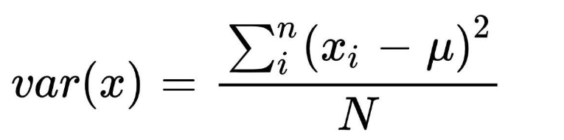
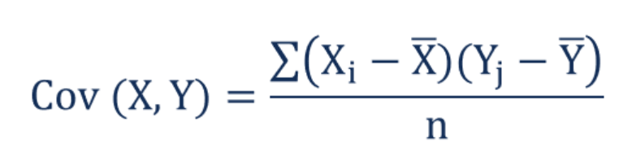
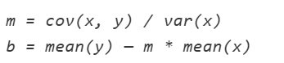
Calculating coefficient of the equation:

Slide 7
Assumptions of Simple Linear RegressioN
Linear regression is a powerful tool for understanding and predicting the behavior of a variable, however, it needs to meet a few conditions in order to be accurate and dependable solutions.
Linearity
Independence
Homoscedasticity
Normality:

Slide 8
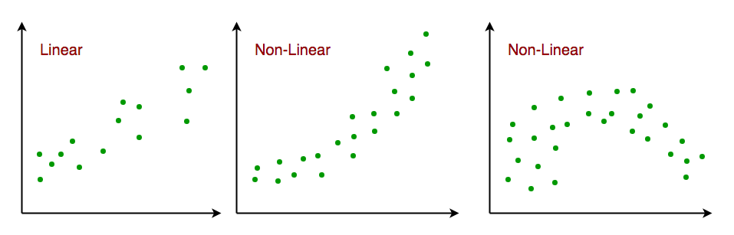
1. Linearity:
The independent and dependent variables have a linear relationship with one another. This implies that changes in the dependent variable follow those in the independent variable(s) in a linear fashion. This means that there should be a straight line that can be drawn through the data points. If the relationship is not linear, then linear regression will not be an accurate model.

Slide 9
2. Independence:
The observations in the dataset are independent of each other. This means that the value of the dependent variable for one observation does not depend on the value of the dependent variable for another observation. If the observations are not independent, then linear regression will not be an accurate model.

Slide 10
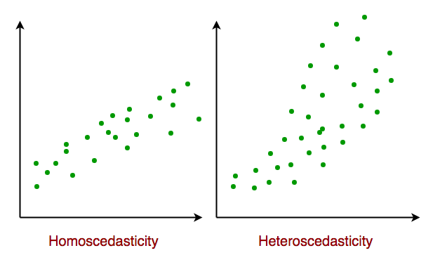
3. Homoscedasticity:
Across all levels of the independent variable(s), the variance of the errors is constant. This indicates that the amount of the independent variable(s) has no impact on the variance of the errors. If the variance of the residuals is not constant, then linear regression will not be an accurate model.

Slide 11
4. Normality:
The residuals should be normally distributed. This means that the residuals should follow a bell-shaped curve. If the residuals are not normally distributed, then linear regression will not be an accurate model.

Slide 12
Prediction of speed based on AGE
DR. Rakhee Chhibber

Slide 13
Draw a scatter plot
import matplotlib.pyplot as plt x = [5,7,8,7,2,17,2,9,4,11,12,9,6] y = [99,86,87,88,111,86,103,87,94,78,77,85,86] plt.scatter(x, y) plt.show()

Slide 14
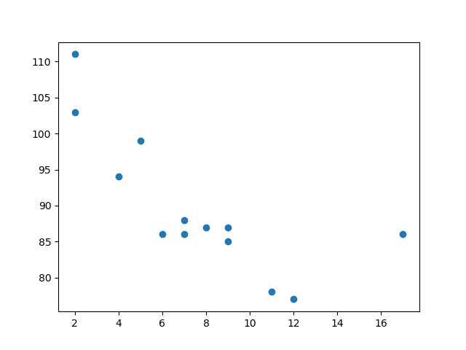

Slide 15
Draw the line of regression
import matplotlib.pyplot as plt from scipy import stats x = [5,7,8,7,2,17,2,9,4,11,12,9,6] y = [99,86,87,88,111,86,103,87,94,78,77,85,86] slope, intercept, r, p, std_err = stats.linregress(x, y) def myfunc(x): return slope * x + intercept mymodel = list(map(myfunc, x)) plt.scatter(x, y) plt.plot(x, mymodel) plt.show()

Slide 16
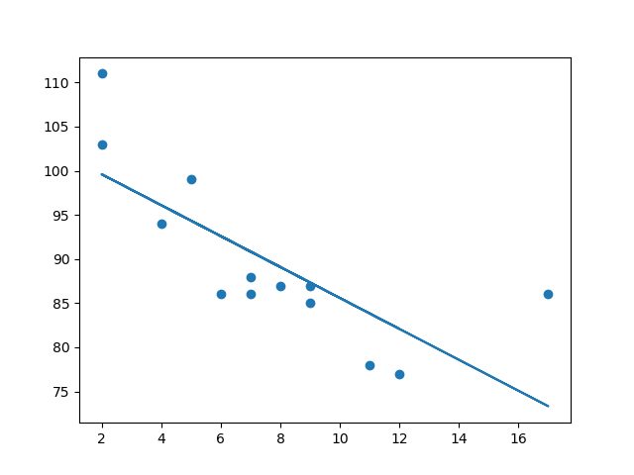

Slide 17
Import the modules
import matplotlib.pyplot as plt from scipy import stats

Slide 18
Create the arrays that represent the values of the x and y axis:
x = [5,7,8,7,2,17,2,9,4,11,12,9,6] y = [99,86,87,88,111,86,103,87,94,78,77,85,86]

Slide 19
Execute a method that returns some important key values of Linear Regression:
slope, intercept, r, p, std_err = stats.linregress(x, y)

Slide 20
Create a function that uses the slope and intercept values to return a new value. This new value represents where on the y-axis the corresponding x value will be placed:
def myfunc(x):
return slope * x + intercept

Slide 21
Run each value of the x array through the function. This will result in a new array with new values for the y-axis:
mymodel = list(map(myfunc, x))

Slide 22
Draw the original scatter plot:
plt.scatter(x, y)

Slide 23
Draw the line of linear regression
plt.plot(x, mymodel)

Slide 24
Display the diagram:
plt.show()

Slide 25
R for Relationship
It is important to know how the relationship between the values of the x-axis and the values of the y-axis is, if there are no relationship the linear regression can not be used to predict anything.
This relationship - the coefficient of correlation - is called r.
The r value ranges from -1 to 1, where 0 means no relationship, and 1 (and -1) means 100% related.
Python and the Scipy module will compute this value for you, all you have to do is feed it with the x and y values.

Slide 26
How well does my data fit in a linear regression?
from scipy import stats x = [5,7,8,7,2,17,2,9,4,11,12,9,6] y = [99,86,87,88,111,86,103,87,94,78,77,85,86] slope, intercept, r, p, std_err = stats.linregress(x, y) print(r)

Slide 27
Predict Future Values
Now we can use the information we have gathered to predict future values.
Example: Let us try to predict the speed of a 10 years old car.
To do so, we need the same myfunc() function from the example above
def myfunc(x): return slope * x + intercept

Slide 28
Predict the speed of a 10 years old car:
from scipy import stats x = [5,7,8,7,2,17,2,9,4,11,12,9,6] y = [99,86,87,88,111,86,103,87,94,78,77,85,86] slope, intercept, r, p, std_err = stats.linregress(x, y) def myfunc(x): return slope * x + intercept speed = myfunc(10) print(speed)

Slide 29
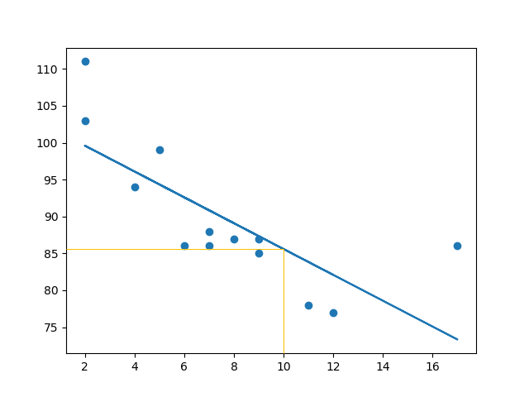
Result - The example predicted a speed at 85.6, which we also could read from the diagram:

Slide 30
Bad Fit? Example

Slide 31
These values for the x- and y-axis should result in a very bad fit for linear regression:
import matplotlib.pyplot as plt from scipy import stats x = [89,43,36,36,95,10,66,34,38,20,26,29,48,64,6,5,36,66,72,40] y = [21,46,3,35,67,95,53,72,58,10,26,34,90,33,38,20,56,2,47,15] slope, intercept, r, p, std_err = stats.linregress(x, y) def myfunc(x): return slope * x + intercept mymodel = list(map(myfunc, x)) plt.scatter(x, y) plt.plot(x, mymodel) plt.show()

Slide 32
r for relationship?
import numpy from scipy import stats x = [89,43,36,36,95,10,66,34,38,20,26,29,48,64,6,5,36,66,72,40] y = [21,46,3,35,67,95,53,72,58,10,26,34,90,33,38,20,56,2,47,15] slope, intercept, r, p, std_err = stats.linregress(x, y) print(r)

Slide 33
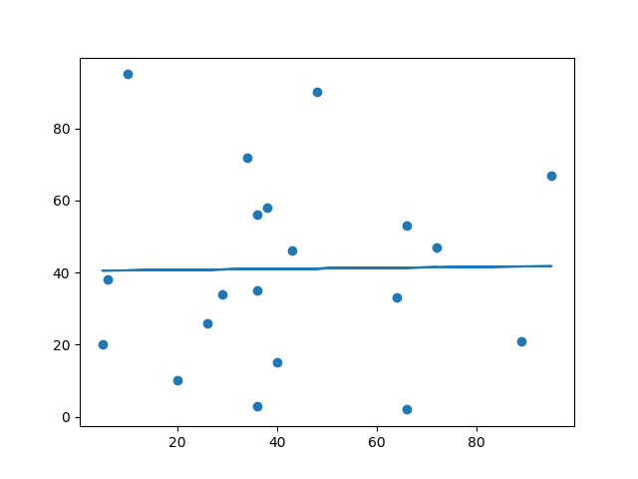
The result: 0.013 indicates a very bad relationship, and tells us that this data set is not suitable for linear regression.

Slide 34
Evaluation Metrics for Linear Regression

Slide 35
Metrics for Linear Regression
A variety of evaluation measures can be used to determine the strength of any linear regression model. These assessment metrics often give an indication of how well the model is producing the observed outputs.
The most common measurements are:
Mean Square Error (MSE)
Mean Absolute Error (MAE)
Root Mean Squared Error (RMSE)
Coefficient of Determination (R-squared)
Adjusted R-Squared Error

Slide 36
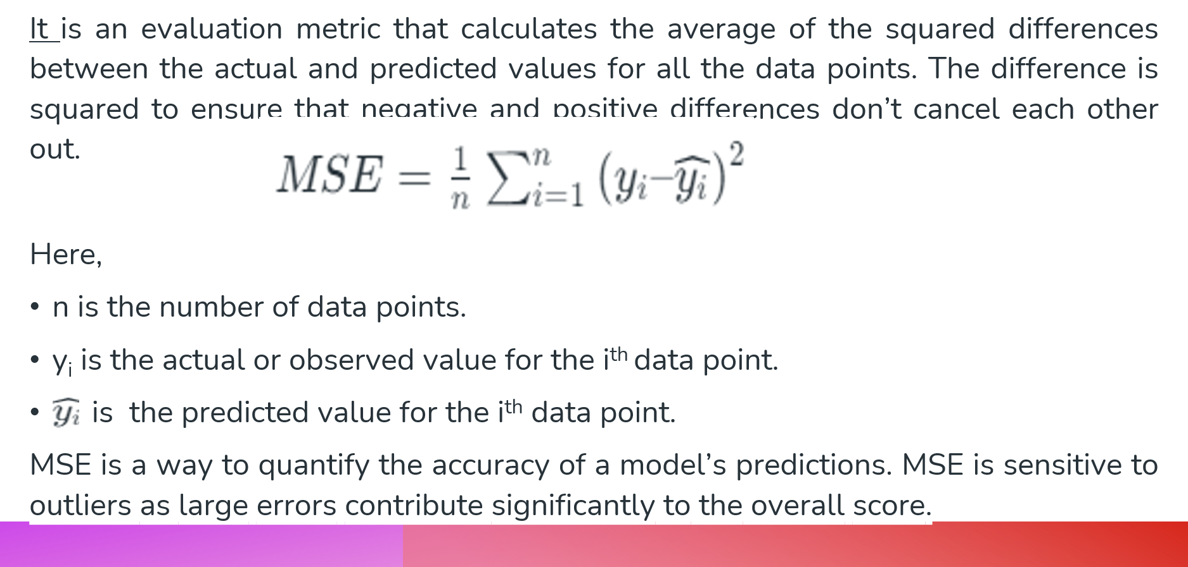
Mean Square Error (MSE)

Slide 37
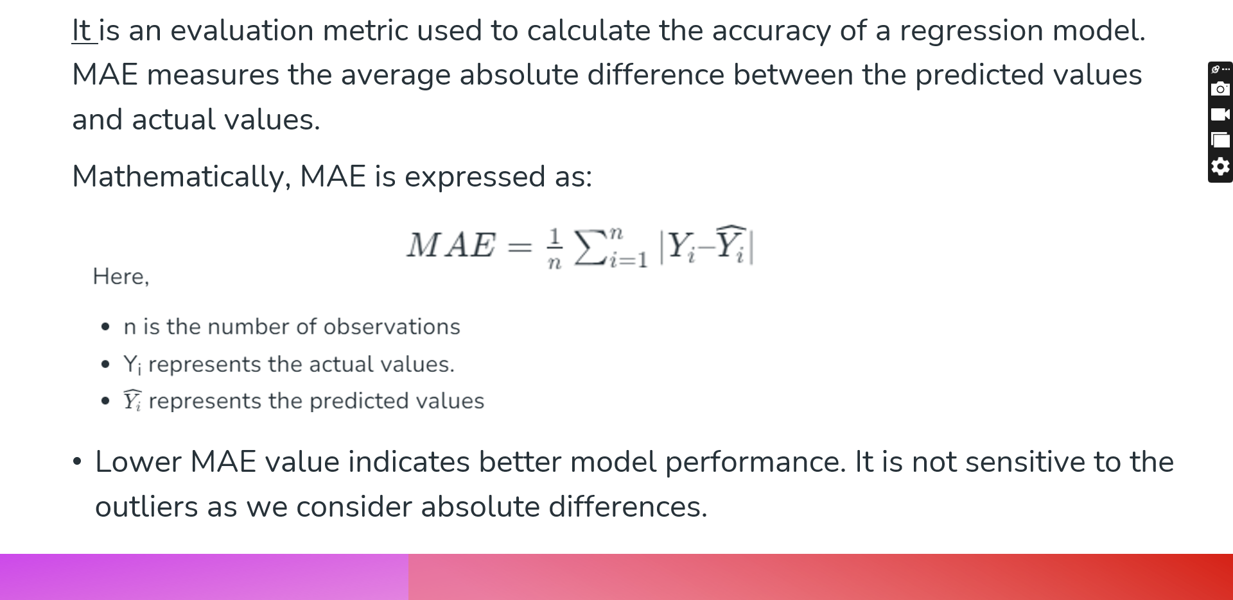
Mean Absolute Error (MAE)

Slide 38
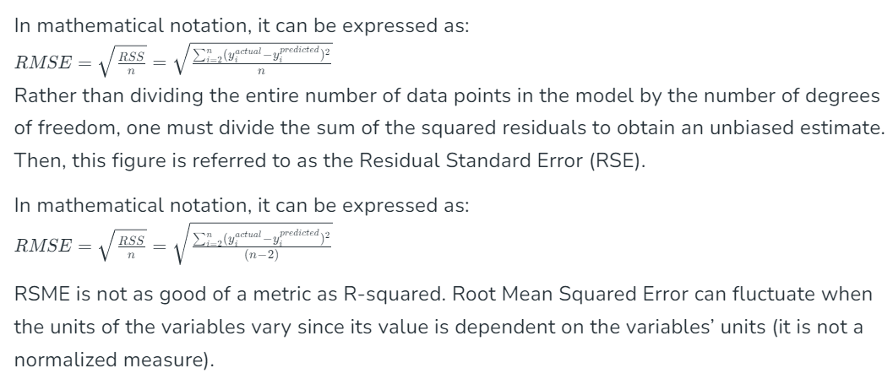
Root Mean Squared Error (RMSE)
The square root of the residuals’ variance is the Root Mean Squared Error. It describes how well the observed data points match the expected values, or the model’s absolute fit to the data.
RSME is not as good of a metric as R-squared. Root Mean Squared Error can fluctuate when the units of the variables vary since its value is dependent on the variables’ units (it is not a normalized measure).

Slide 39
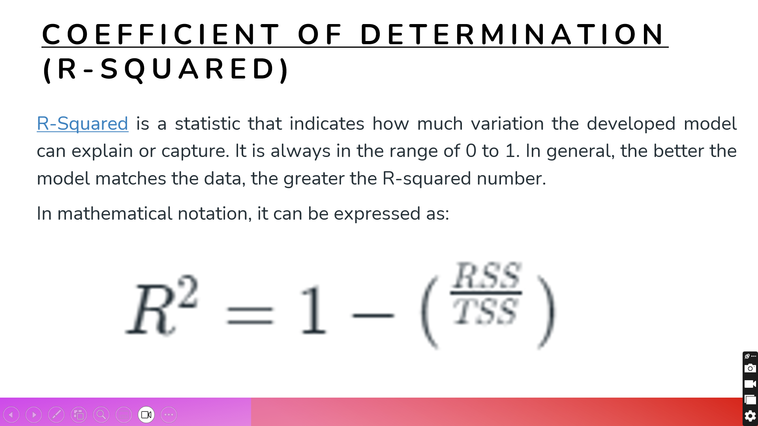

Slide 40
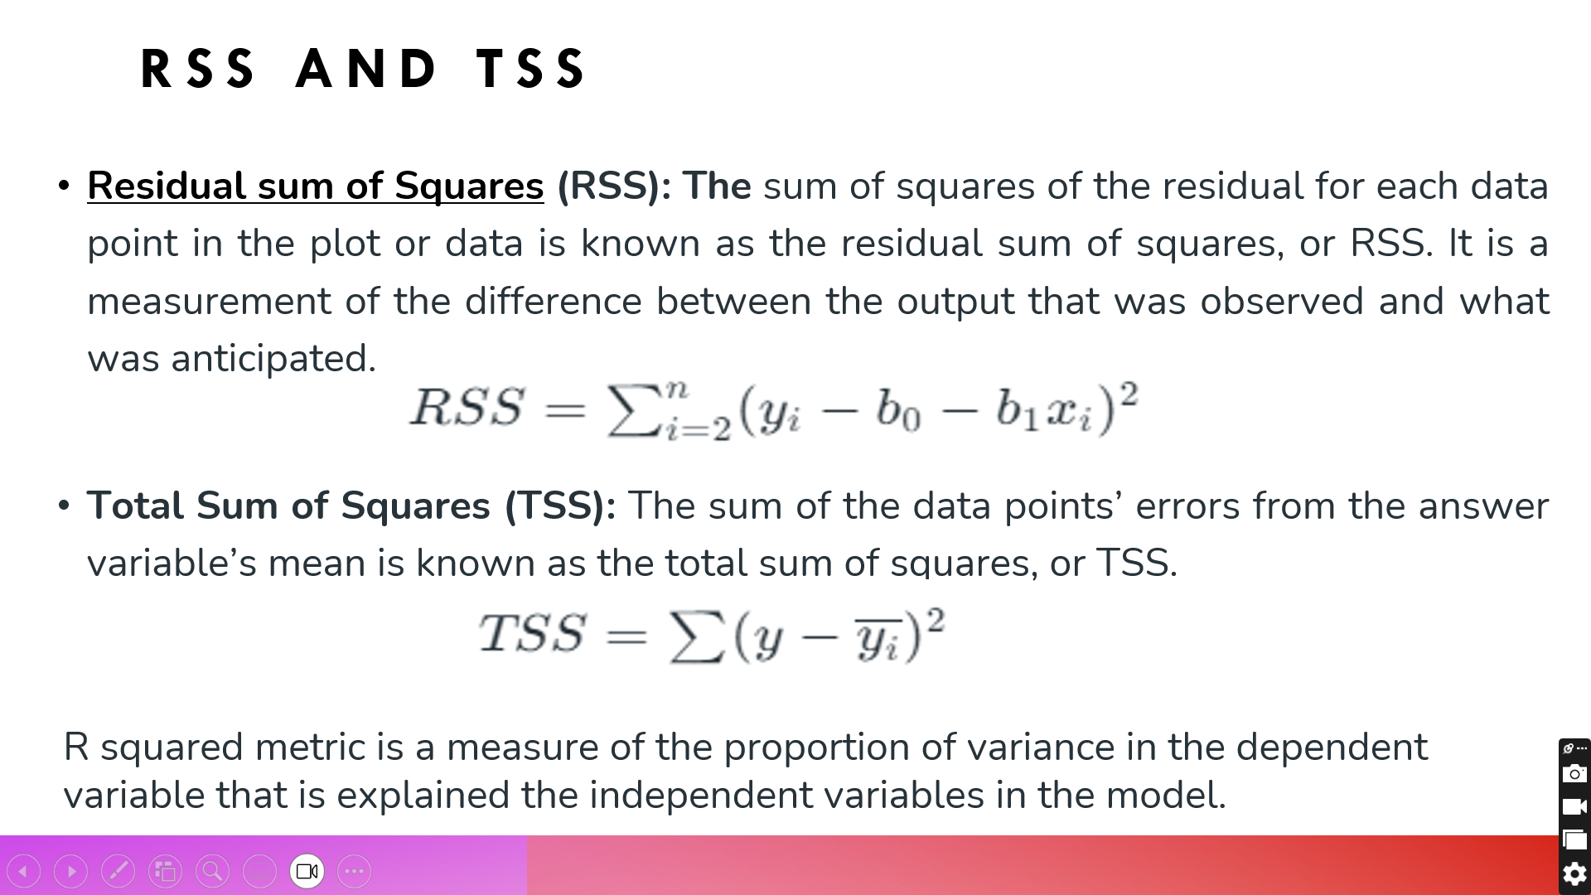

Slide 41
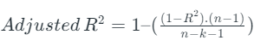
Adjusted R-Squared Error
Adjusted R² measures the proportion of variance in the dependent variable that is explained by independent variables in a regression model. Adjusted R-square accounts the number of predictors in the model and penalizes the model for including irrelevant predictors that don’t contribute significantly to explain the variance in the dependent variables.
Mathematically, adjusted R² is expressed as:
Here,
n is the number of observations
k is the number of predictors in the model
R² is coefficient of determination
Adjusted R-square helps to prevent overfitting. It penalizes the model with additional predictors that do not contribute significantly to explain the variance in the dependent variable.

Slide 42
Thank You

